Slide 1

Urban Sound Classification using Deep Learning
IT-890 Professional Practice
[Feb-May 2021]
Under Supervision of
Prof. Ananthanarayana V. S.
Presented by
Tarushi Jat [202IT029]

Slide 2
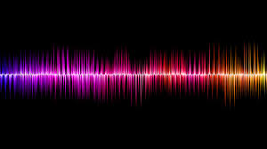
Urban Sound Classification Project Overview
Abstract
Dataset & Working Environment
Workflow of Project
Understanding Audio Signal
Representing Sound Digitally
Feature Extraction
CNN Model
VGG16 Model
Performance Comparison
Conclusion
References
MAY-2021

Slide 3
Abstract
Audio carry a large amount of life scenes and events in the city. From surveillance to house monitoring, sound classification are immense in various work.
Developing a deep learning model that automatically extract this information has huge benefits in developing smart cities.
Aim of this deep learning project is to classify audio data of urban sounds into different classes using MFCC features from audio files.
As an output, the model will try to classify an input audio file into one of the following 10 classes : Air conditioner, Car horn, Children playing, Dog bark, Drilling, Engine idling, Gun shot, Jackhammer, Siren & Street Music.
MAY-2021

Slide 4

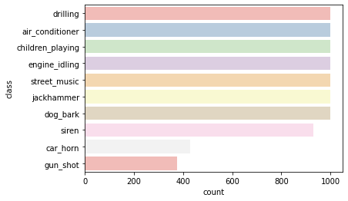
Dataset And Working Environment
Siren
Car Horn
UrbanSound8K Dataset
Contains audio files of <= 4 seconds.
Total number of audio file : 8732
Distributed in 10 classes
Total dataset size : 7GB
System Setup
Google colab environment
UrbanSound8k Dataset from Kaggle
Language : Python
Street Music

Slide 5
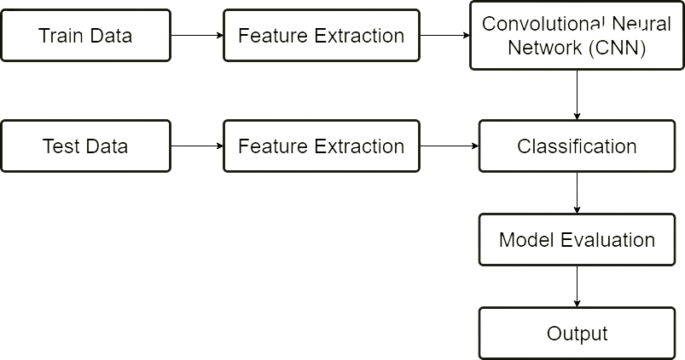
Workflow of the Project

Slide 6
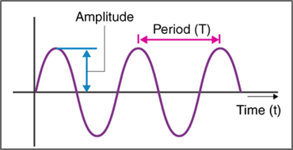
Understanding Audio Signal
A sound signal is produced by
variations in air pressure.
We can measure the intensity of the
pressure variations and plot those
measurements over time.
The majority of sounds we encounter
contains signals of different frequencies
that are added together to create a composite signals with more complex repeating patterns.
These waves can be represented using waveforms that is basically viewed as a function of amplitude over time.
MAY-2021

Slide 7
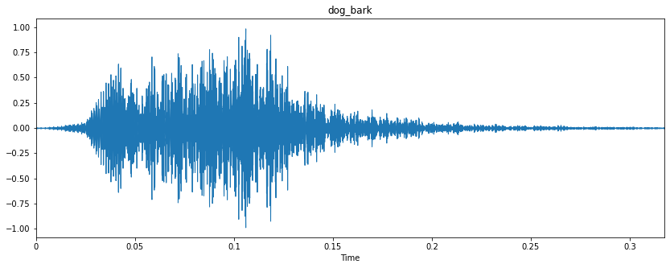
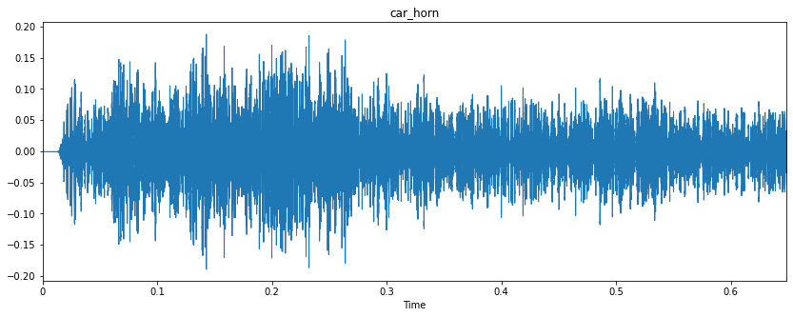
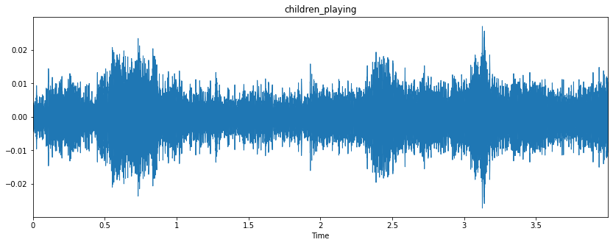
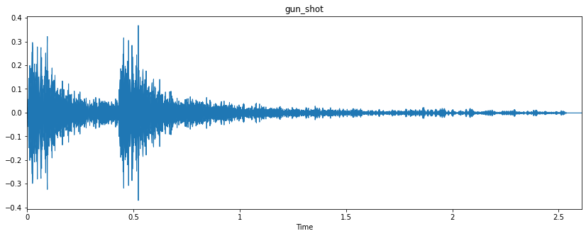
EDA - Waveforms

Slide 8
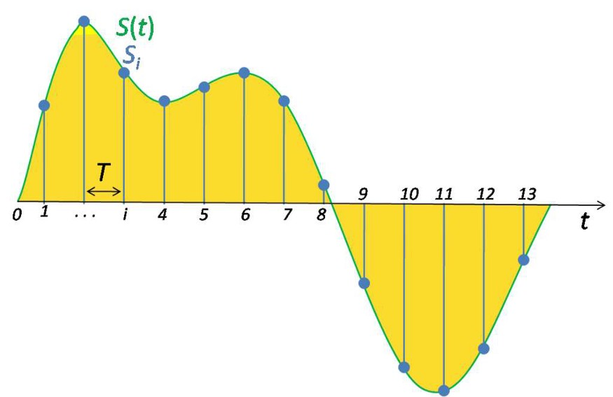
Representing Sound Digitally
Waveforms are analog and cannot be stored and hence we need to convert them into digital signal.
To digitize a sound waveform we must turn the signal into a series of numbers so that we can input it into the models for training.
This is done by measuring the amplitude of the sound at fixed intervals of time.
By default, we take 44,100 samples per second.
Higher sampling rate means that more data will be collected and hence we will get audio of high quality but will result in requiring more computation power.
MAY-2021

Slide 9
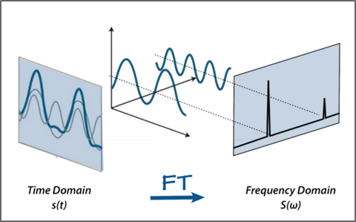
Feature Extraction : Build Up
Fourier Transform:
An audio signal is comprised of several single-frequency sound waves.
FT converts the signal from the time domain into the frequency domain. The result is called a power spectrum.
Problem with Fourier Transform:
Audio data is time series and after doing FT we loose time element of audio signal.
MAY-2021

Slide 10
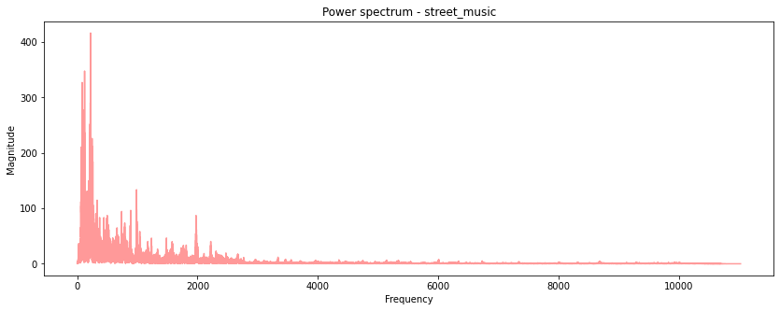
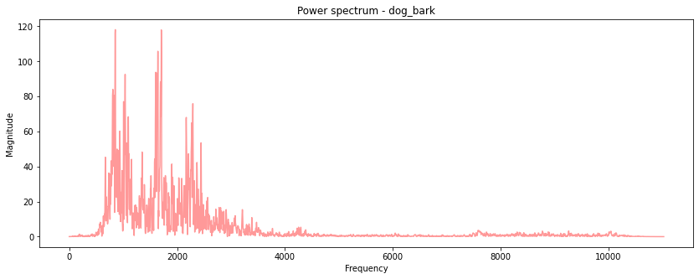
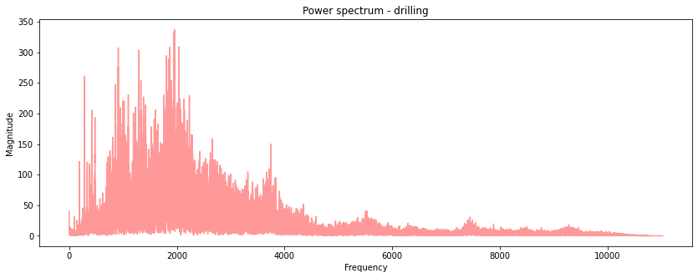
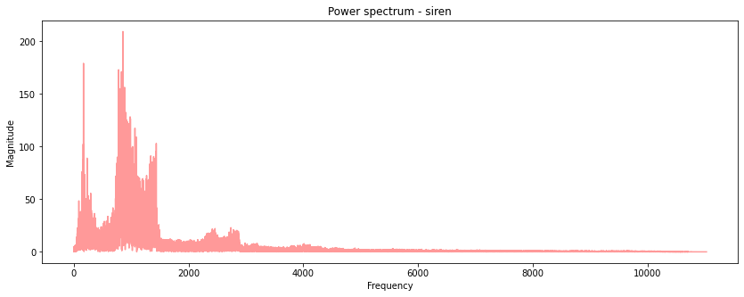
Data Representation - Power Spectrums

Slide 11
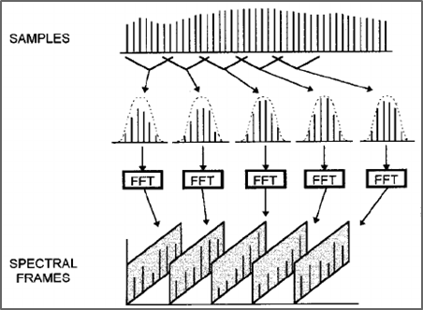
Feature Extraction : Build Up
Short Term Fourier Transform(STFT):
Computes different FT at different time.
Information about time is preserved.
Frame Size in STFT signifies different interval at which we are to perform FT again.
As a result of STFT, we get a spectrogram which gives us information about magnitude as a function of frequency and time.
Sounds that sound drastically different, results in drastically different spectrograms.
MAY-2021

Slide 12
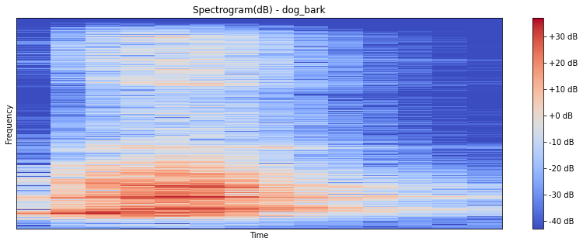
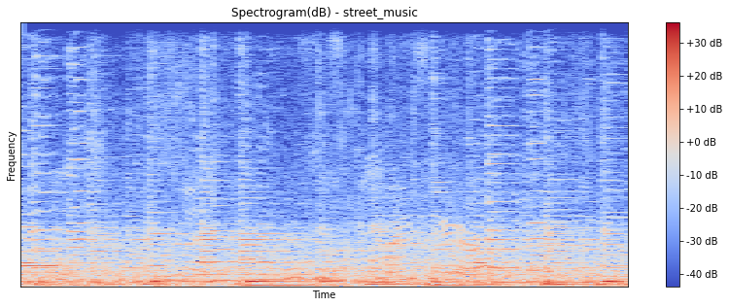
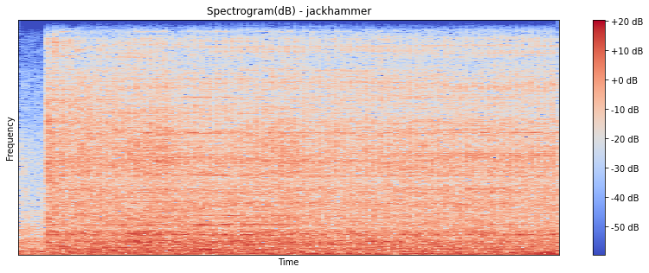
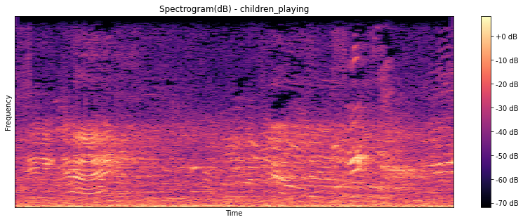
Data Representation - Spectrograms

Slide 13
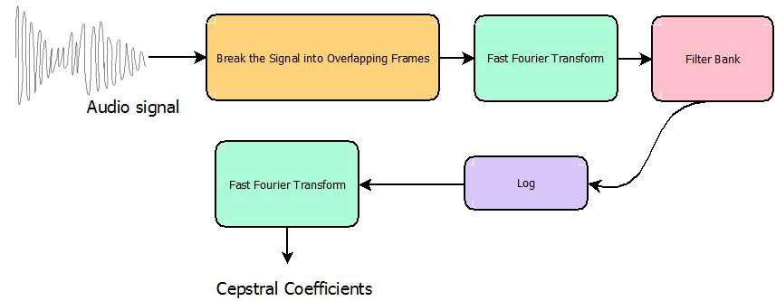
Feature Extraction - MFCC
Stands for Mel Frequency Cepstral
Coefficient.
To compute MFCC, we compute
the mel frequency spectrograms.
After computing mel frequency
spectrogram, we take log of it and
then take discrete cosine transform,
which finally gives us the cepstral
coefficients.
MFCC features of all the audio files are extracted using python’s Librosa library and this will be used to train the CNN model.
Mel Spectrograms: A mel spectrogram is a spectrogram where the frequencies are converted to the mel scale.
Mel Scale: A unit of pitch such that equal distances in pitch sounds equally distant to the listener. This is called the mel scale.
MAY-2021

Slide 14
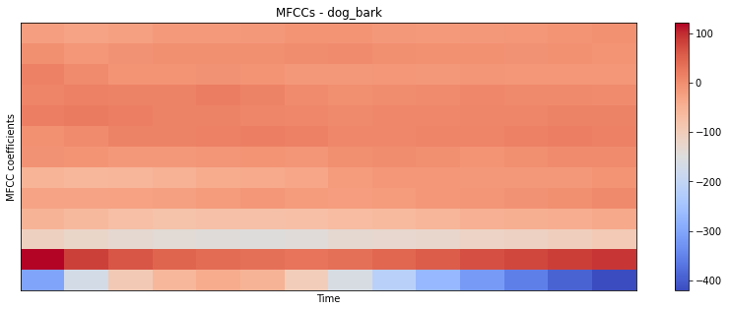
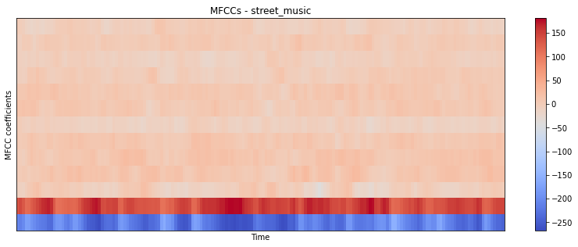
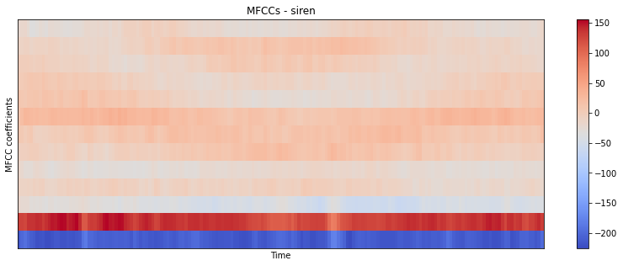
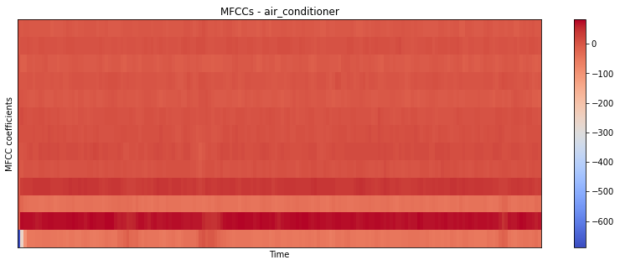
Data Representation - MFCCs

Slide 15
CNN Model
Convolution Layer Details | Hyper Parameters Details
32 filters(3X3), Activation(ReLu), input shape (40, 174, 1) 32 filters(3X3), Activation(ReLu), Maxpooling(2X2) 64 filters(3X3), Activation(ReLu) 64 filters(3X3), Activation(ReLu), Global Average Pooling Dense(10), Activation(Softmax) | Learning rate: 0.0001 Epochs: 250 Batch Size: 128 Optimizer: Adam
MAY-2021

Slide 16
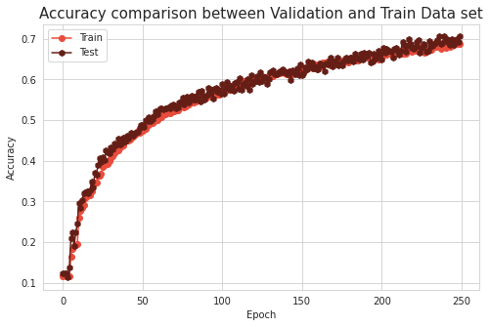
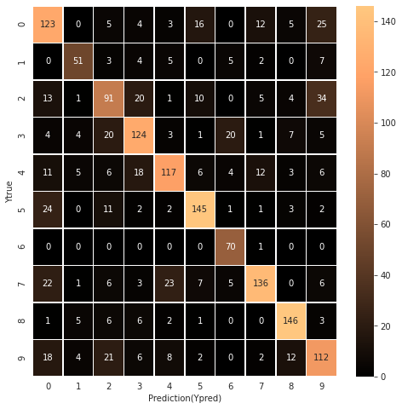
Results Analysis after Training CNN Model
UrbanSound8K Dataset
Train Accuracy: 69.22%
Test Accuracy: 67.49%
Model Training Time: 12 minutes

Slide 17
CNN Model : Performance Tuning
Convolution Layer Details | Hyper Parameters Details
32 filters(3X3), Activation(ReLu), input shape (40, 174, 1), Batch Normalization 32 filters(3X3), Activation(ReLu), Batch Normalization Maxpooling(2X2), 64 filters(3X3), Activation(ReLu), Batch Normalization 64 filters(3X3), Activation(ReLu), Batch Normalization Global Average Pooling Dense(10), Activation(Softmax) | Learning rate: 0.0001 Epochs: 250 Batch Size: 128 Optimizer: Adam

Slide 18
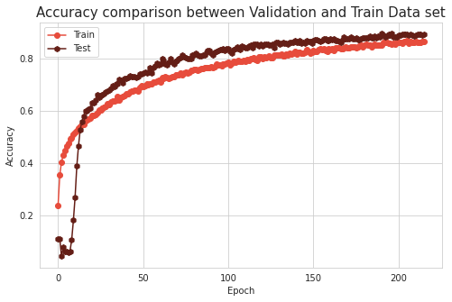
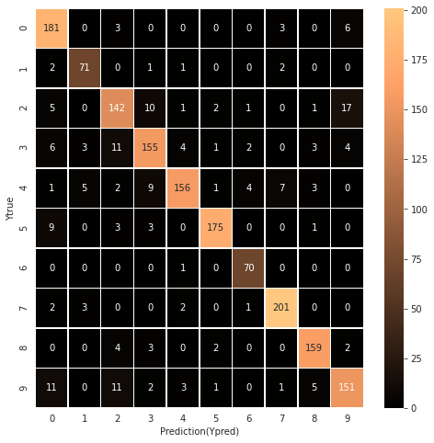
Results Analysis after Training CNN Model
UrbanSound8K Dataset
Train Accuracy: 91.61%
Test Accuracy: 88.43%
Model Training Time: 14 minutes

Slide 19
CNN Model : Performance Tuning
Convolution Layer Details | Hyper Parameters Details
32 filters(3X3), Activation(ReLu), input shape (40, 174, 1), Batch Normalization, Dropout(0.07) 32 filters(3X3), Activation(ReLu), Batch Normalization, Maxpooling(2X2), Dropout(0.07) 64 filters(3X3), Activation(ReLu), Batch Normalization, Dropout(0.14) 64 filters(3X3), Activation(ReLu), Batch Normalization, Global Average Pooling Dense(10), Activation(Softmax) | Learning rate: 0.0001 Epochs: 250 Batch Size: 128 Optimizer: Adam

Slide 20
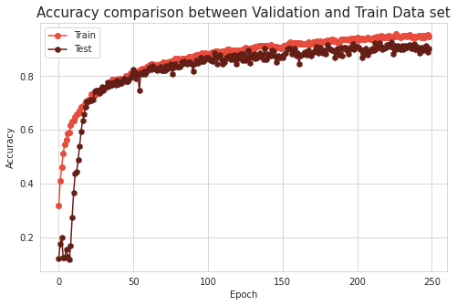

Results Analysis after Training CNN Model
UrbanSound8K Dataset
Train Accuracy: 95.80%
Test Accuracy: 90.98%
Model Training Time: 15 minutes

Slide 21
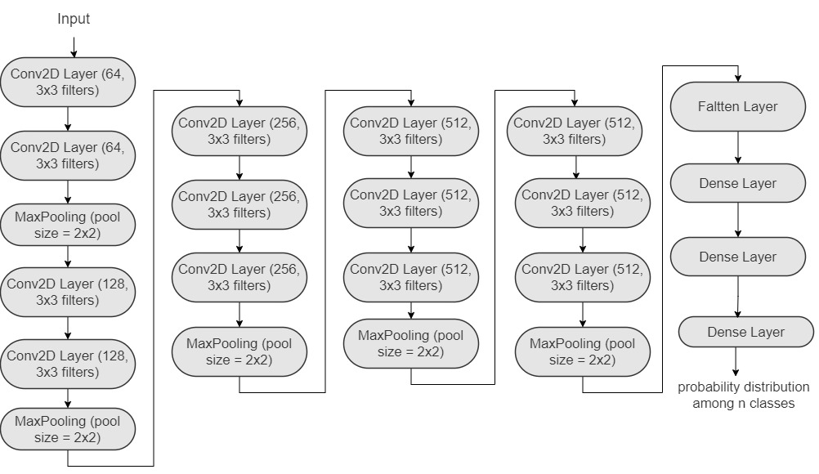
VGG-16 Model
13 convolution layers
uses relu activation function
each convolution layer uses filter of size 3X3
after every 2 or 3 convolution layer, max pooling is used with pool size of 2X2
At last, 3 dense layers are used.
MAY-2021

Slide 22
Hyperparameter Details
Hyperparameter | Value
Learning Rate | 0.0001
Batch Size | 128
Epochs | 250
Optimizer | Adam
MAY-2021

Slide 23
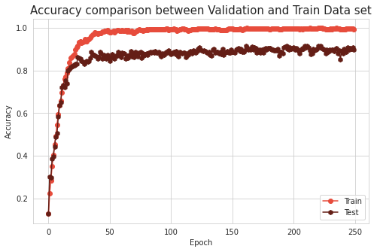
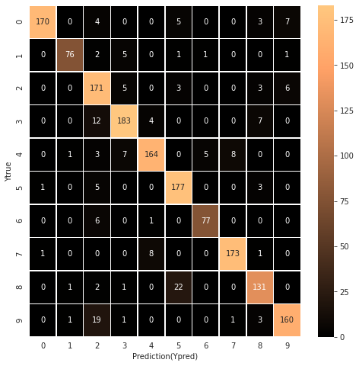
Results Analysis after Training VGG-16 Model
UrbanSound8K Dataset
Train Accuracy: 98.93%
Test Accuracy: 91.28%
Model Training Time: 58 minutes

Slide 24
Performance Comparison
Model | Accuracy
CNN Model | 67.49
CNN : Performance Tuning (01) | 88.43
CNN : Performance Tuning (02) | 90.98
VGG16 Model | 91.28
MAY-2021

Slide 25
Conclusion
In this project, I have implemented urban sound classification using UrbanSound8K dataset with the 2 different convolutional neural network architecture.
Both CNN model was trained with MFCC features that were extracted from our audio files.
The highest accuracy achieved using UrbanSound8K dataset was 91.28% on test dataset.
MAY-2021

Slide 26
References
UrbanSound8K Dataset
https://www.kaggle.com/chrisfilo/urbansound8k
Urban Sound Classification
http://noiselab.ucsd.edu/ECE228_2019/Reports/Report36.pdf
Urban sound classification based on 2-order dense convolutional network using dual features
https://www.sciencedirect.com/science/article/abs/pii/S0003682X19312691#:~:text=A%20novel%20urban%20sound%20classification%20model%20is%20proposed%20based%20on,method%20for%20urban%20sound%20classification
MAY-2021

Slide 27
THANK YOU!

